Slide 1
Object Oriented Programming CS F213 Amit Dua

Slide 2
Types of Design Patterns
Creational:
It deals about class instantiation or object creation.
Further classified into class creational patterns and object creational patterns.
Eg. Factory method, abstract factory, singleton and builder
Structural:
It is about organizing different classes and objects to form larger structures and provide new functionality.
Eg. Adapter, Composite, Decorator, Proxy
Behavioral:
It is about identifying common communication patterns between objects
Eg. Iterator, State, Strategy, Observer, Command, Chain of Responsibility

Slide 3

Creational Design Pattern

Slide 4
Builder Pattern

Slide 5
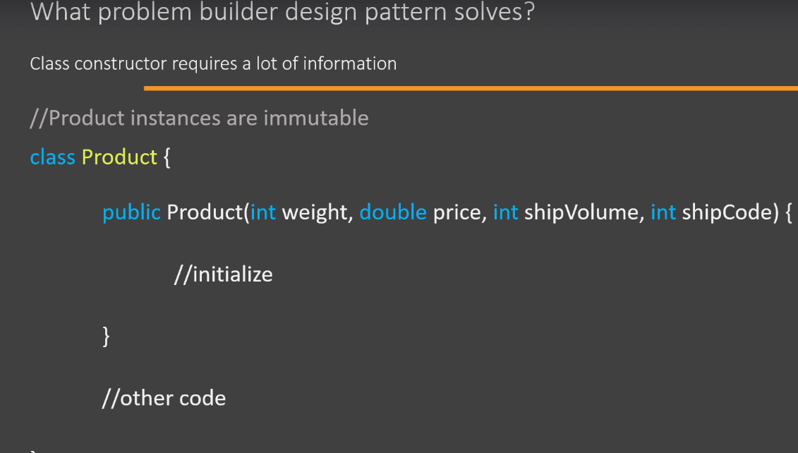
Motivation

Slide 6
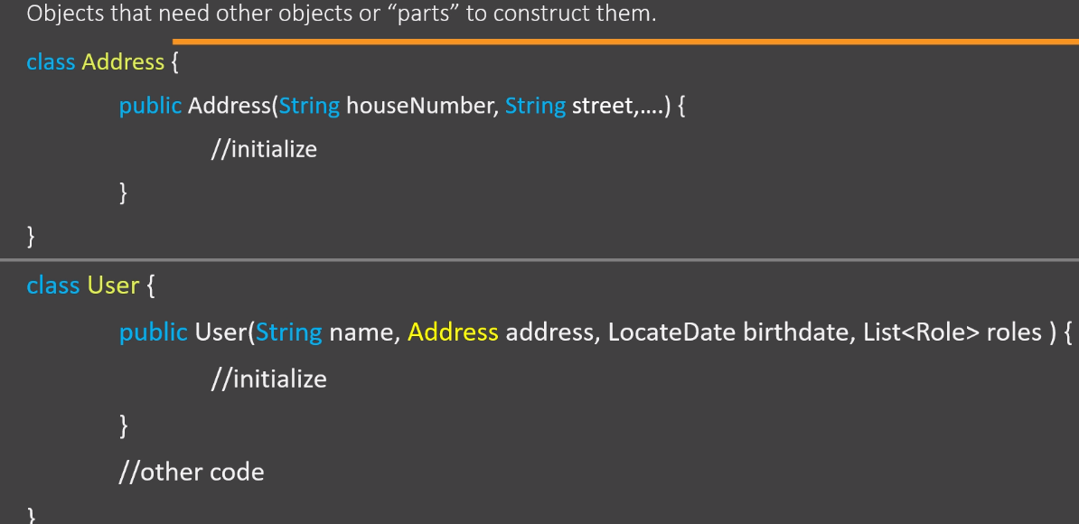
Motivation

Slide 7
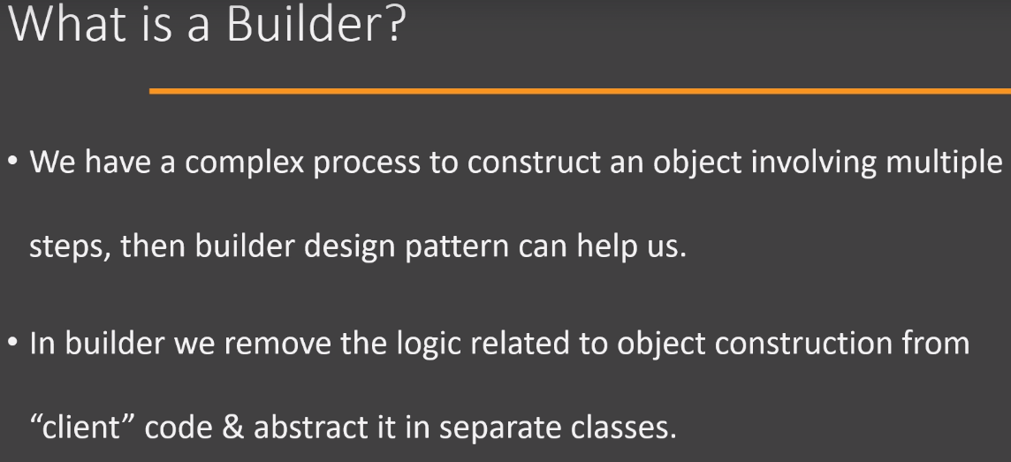
Definition

Slide 8
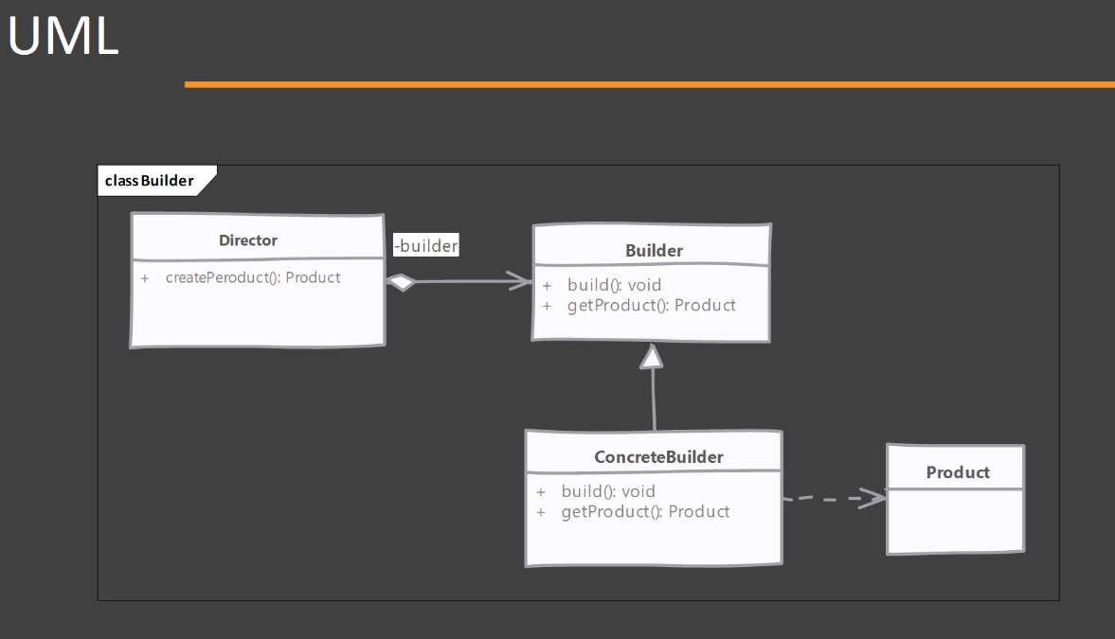
Class Diagram

Slide 9
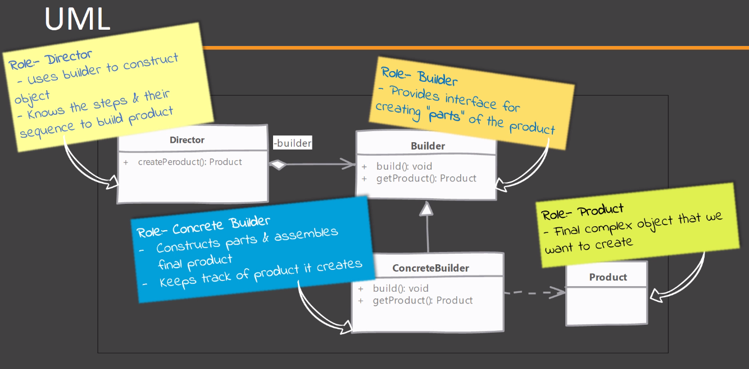
Class diagram Explained

Slide 10
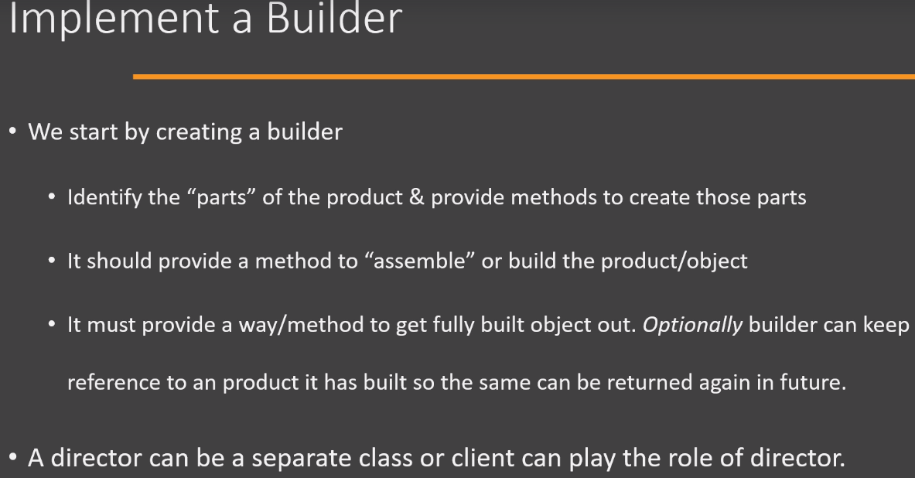
Steps for Implementation

Slide 11
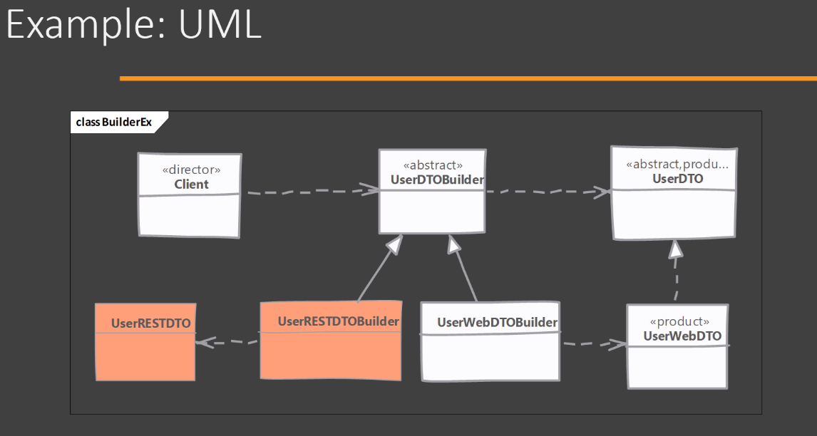
Example

Slide 12
Builder Pattern
Factory or Abstract factory design patterns will not be suitable when the Object contains a lot of attributes.
Issues:
Passing too many parameters from the client program to the factory class can be error prone because most of the time, the type of the parameters are same and it is difficult to maintain the order of the arguments at the client side.
Some parameters might be optional but we are forced to send NULL when factory pattern is used.
Builder pattern solves the issues by providing a step by step way to build the object.

Slide 13
Ques

Slide 14
Other Creational Design Patterns
Singleton
Factory
Abstract Factory
-Builder

Slide 15

Structural Design Patterns

Slide 16
Adapter Pattern

Slide 17
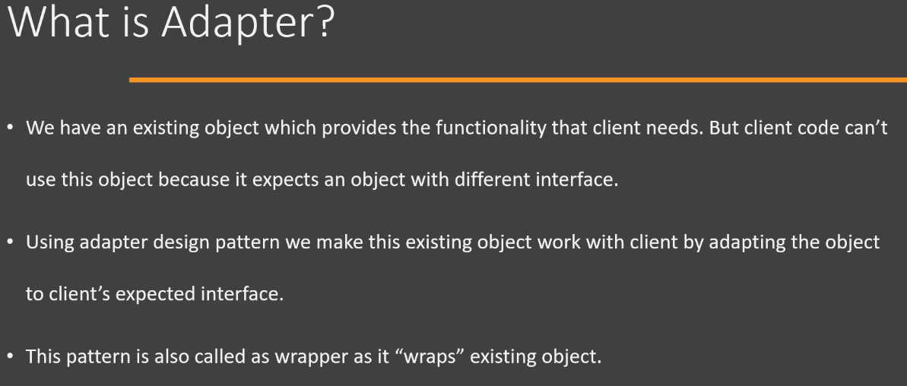
Definition

Slide 18
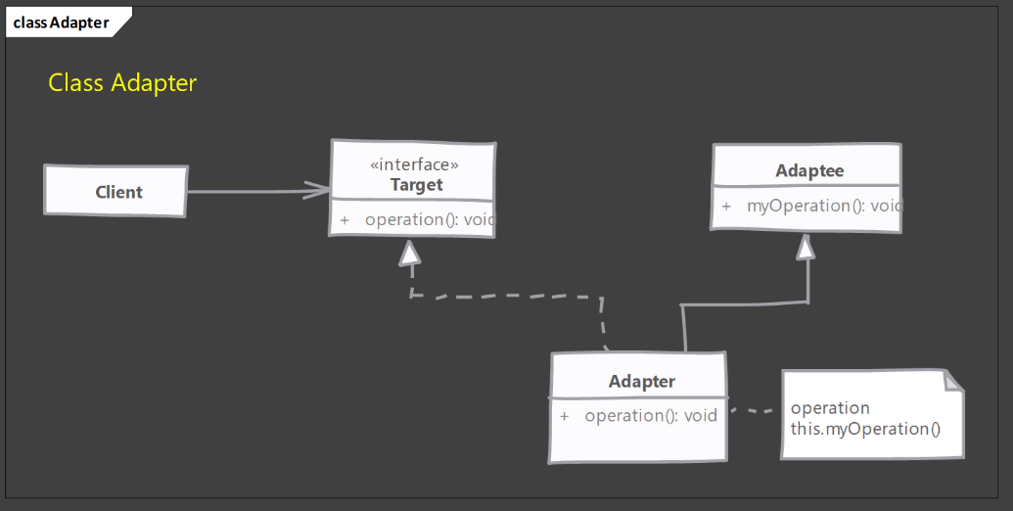
Class Diagram (using inheritance)

Slide 19
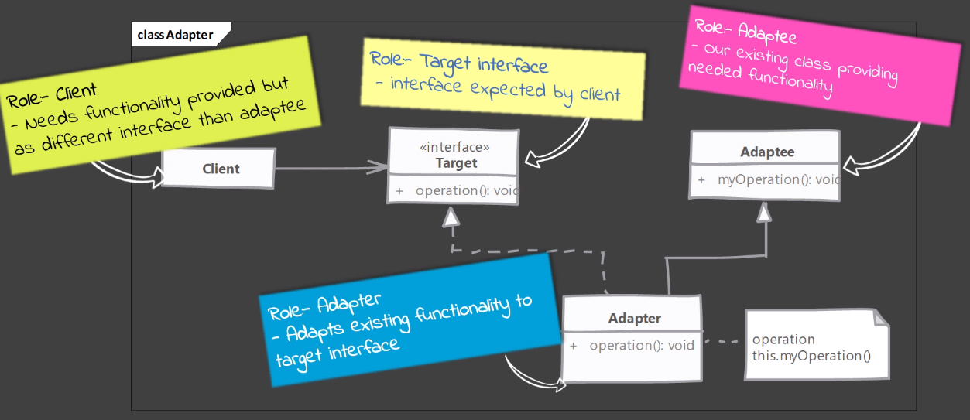
Class diagram explained

Slide 20
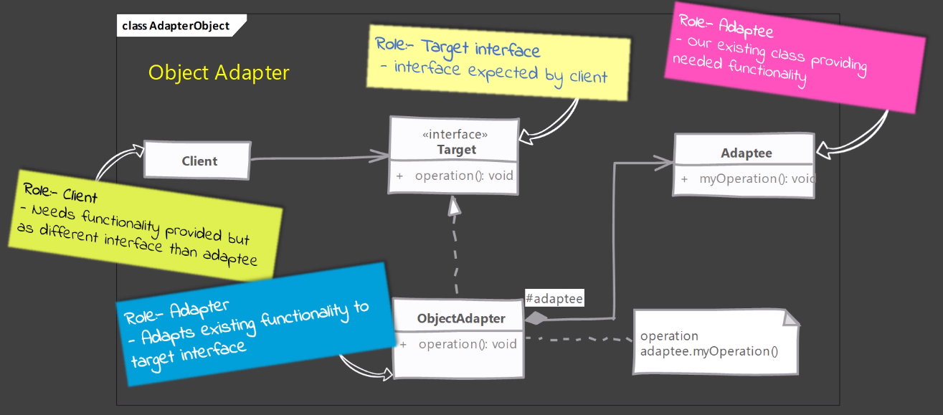
Preferred (using composition)

Slide 21
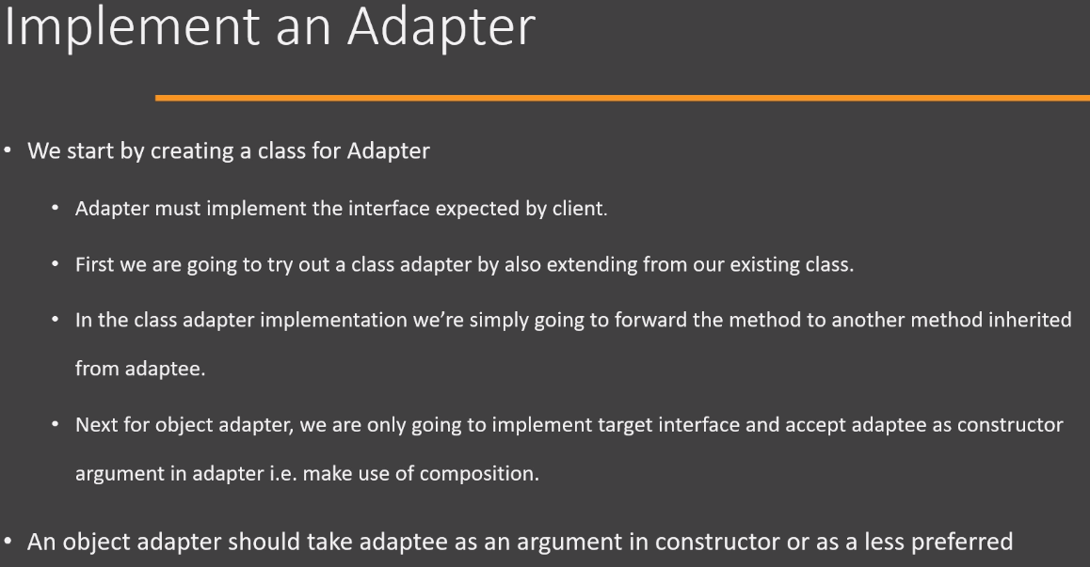
Implementation

Slide 22
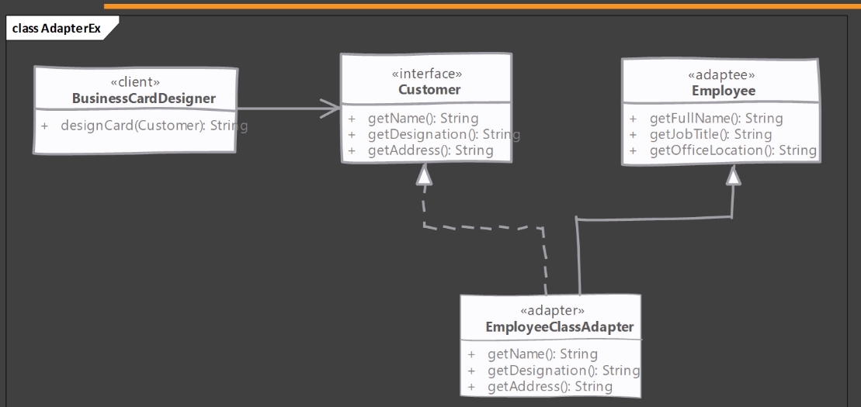
Example (using inheritence)

Slide 23
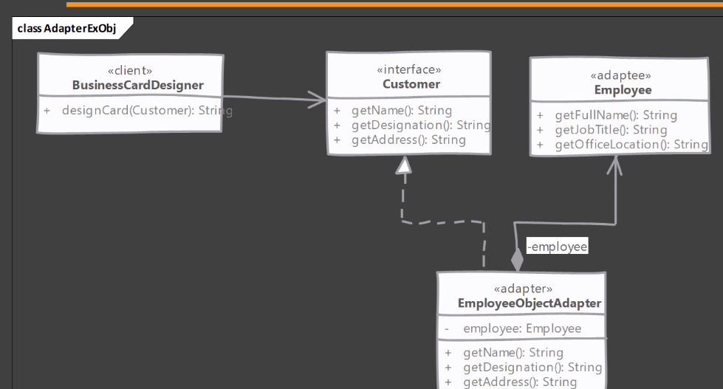
Example (using composition)

Slide 24
Ques

Slide 25
Bridge Pattern

Slide 26
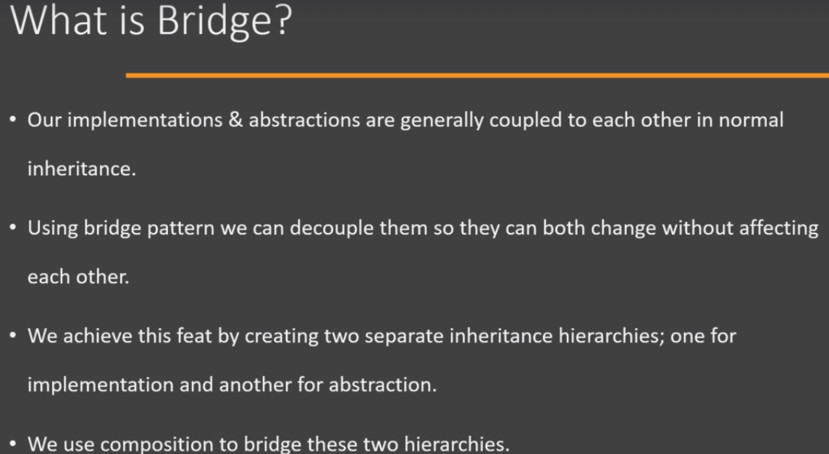
Definition

Slide 27
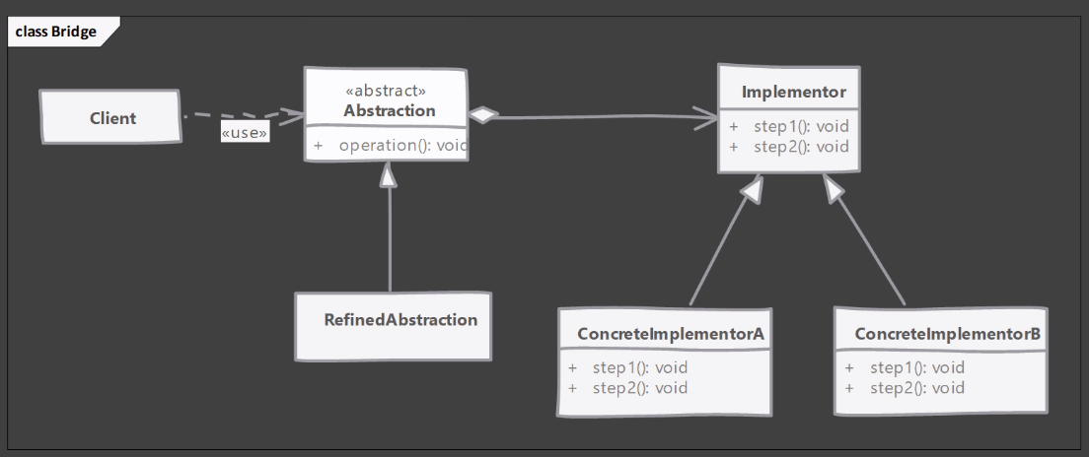
Class Diagram

Slide 28
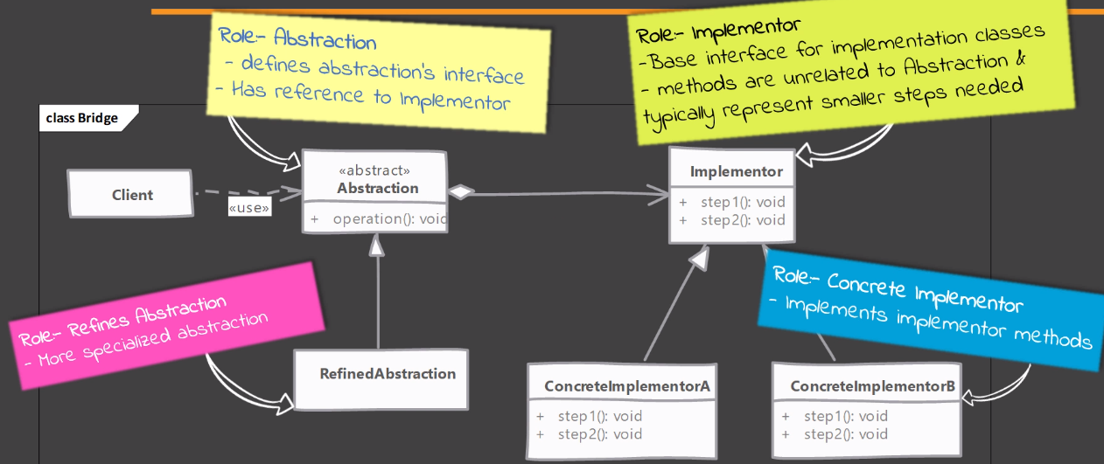
Class Diagram Explained

Slide 29
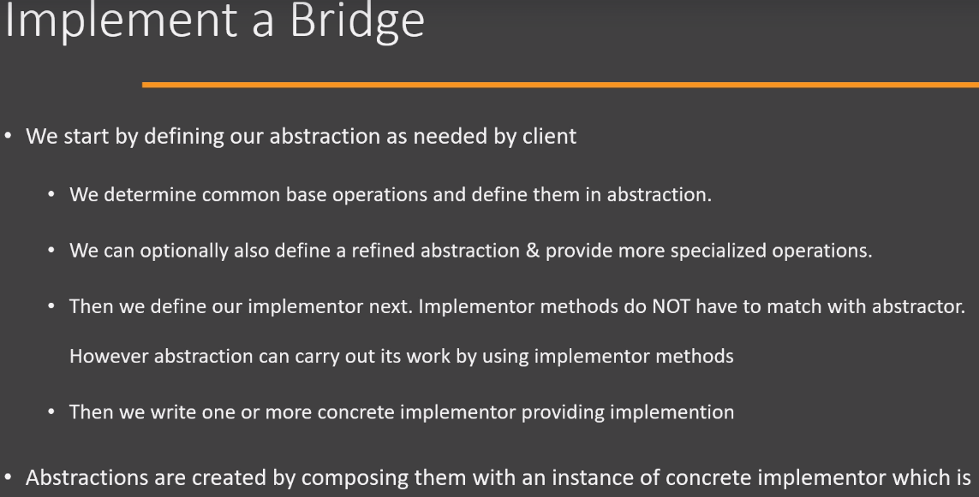
Implementation

Slide 30
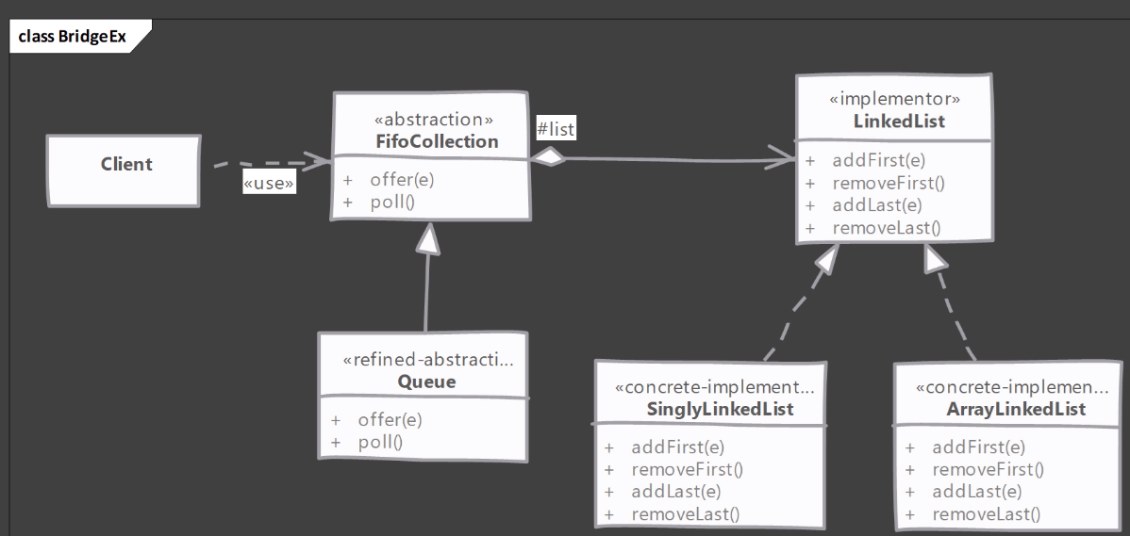
Example

Slide 31
Questions?
-Builder
-Adapter
-Bridge

Slide 32
Composite Pattern

Slide 33
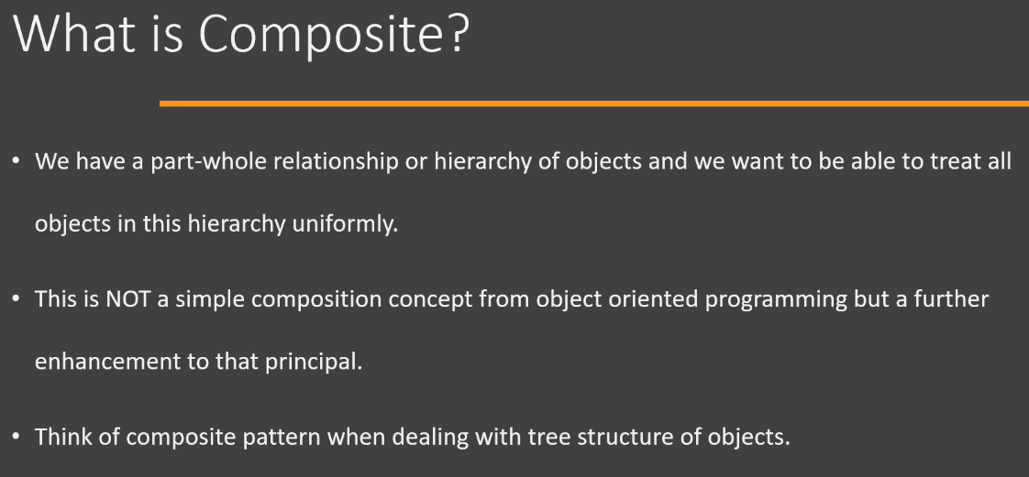
Definition

Slide 34
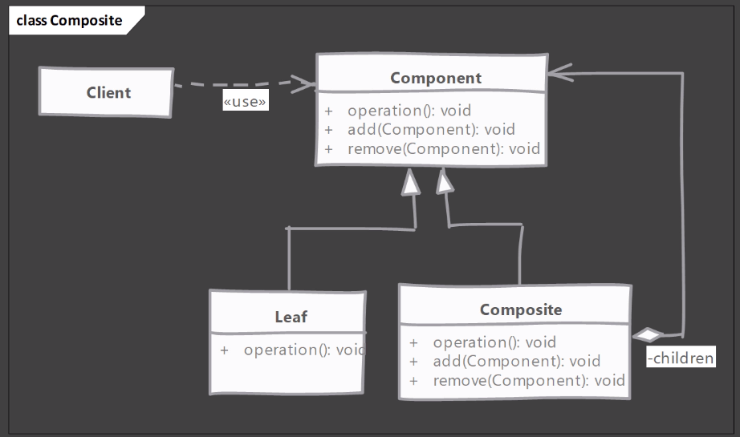
Class Diagram

Slide 35
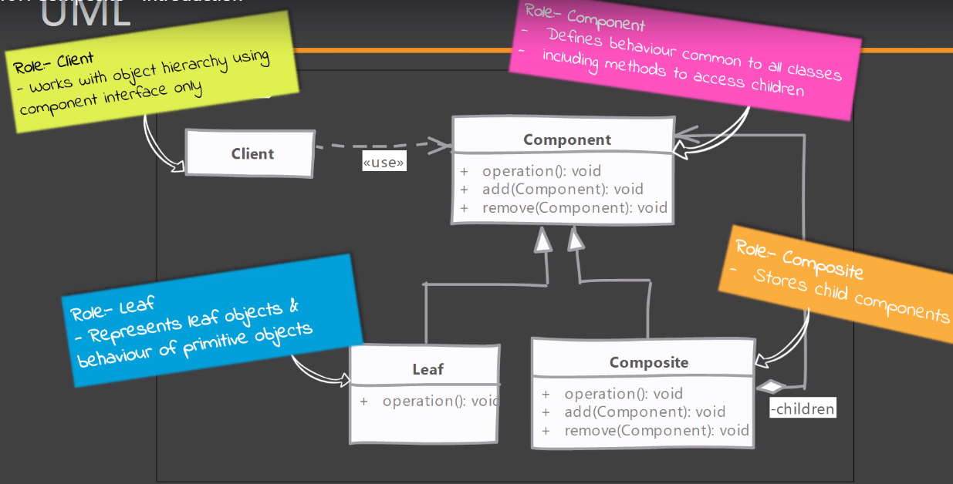
Class Diagram Explained

Slide 36
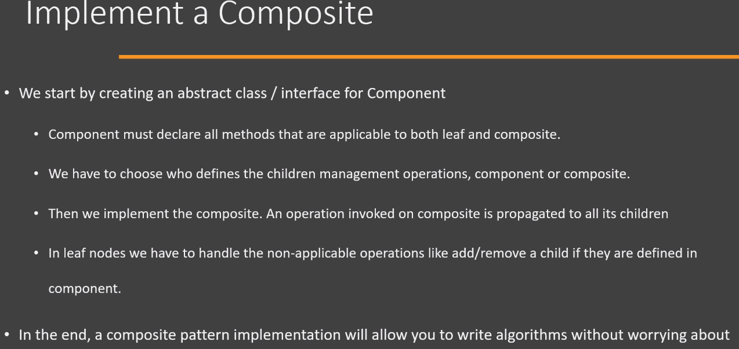
Implementation

Slide 37
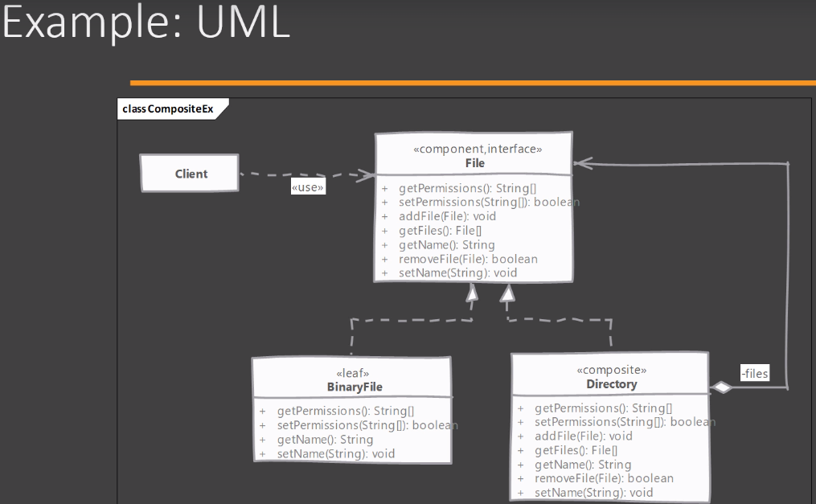
Example

Slide 38
Questions
-Adapter
-Bridge
-Composite

Slide 39
Proxy Pattern

Slide 40
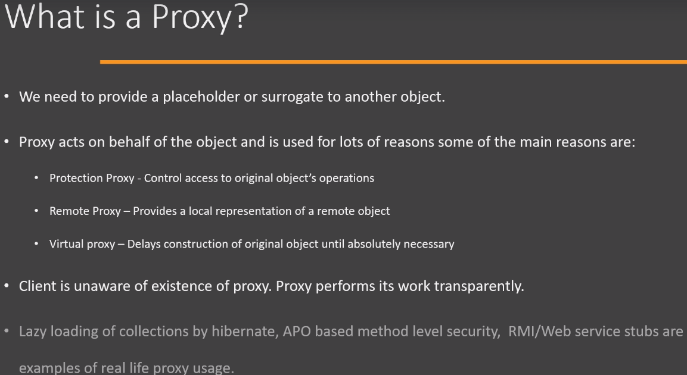
Definition

Slide 41
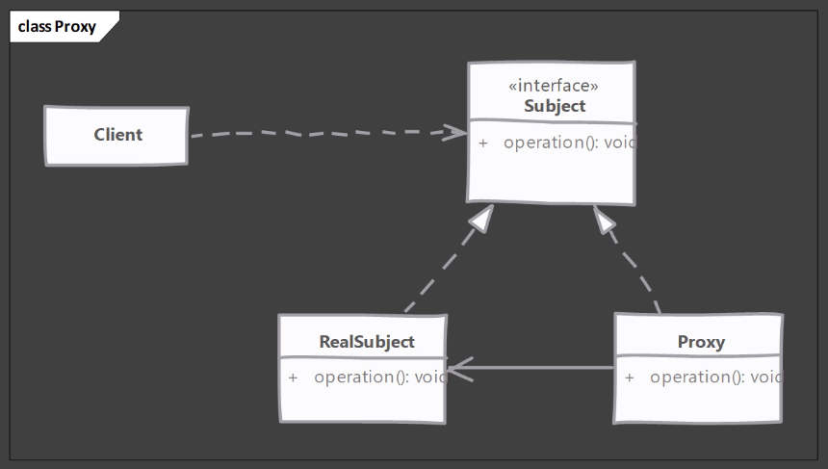
UML class diagram

Slide 42
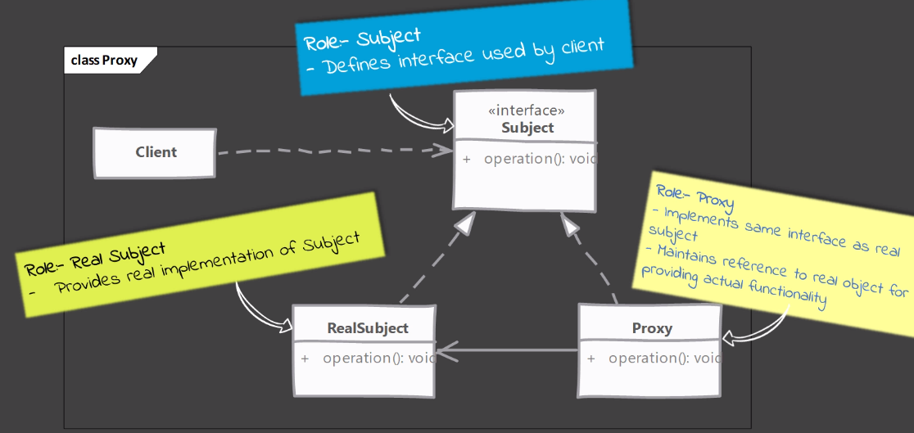
Class diagram

Slide 43
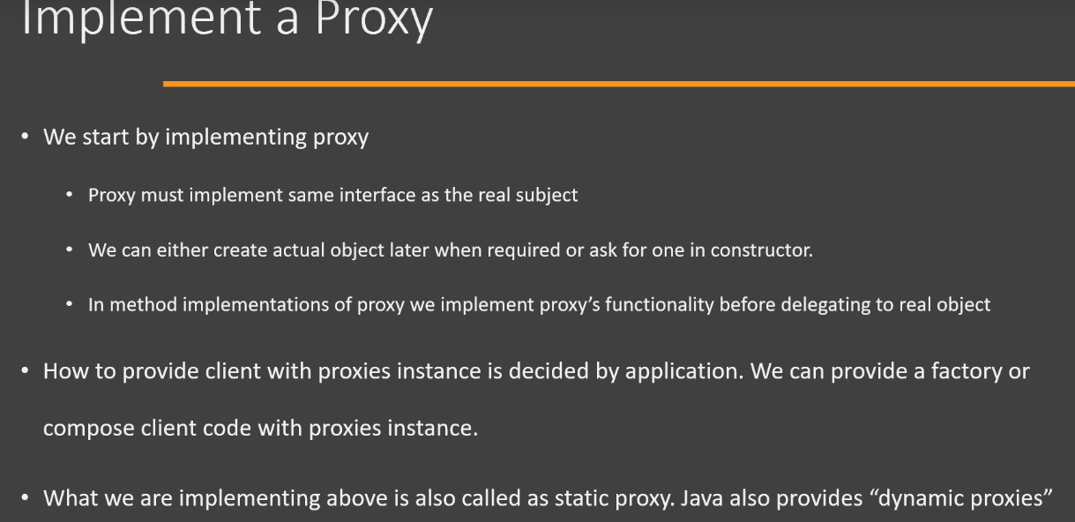
Implementation

Slide 44
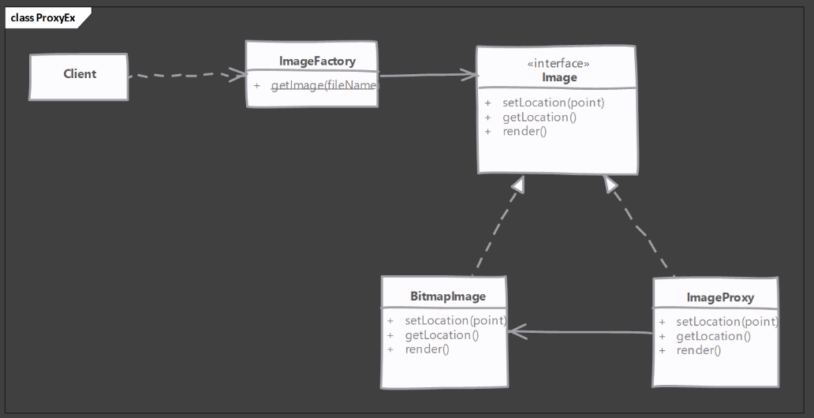
Example

Slide 45
Ques
Structural design patterns
Adapter
Bridge
Composite
Proxy
Decorator

Slide 46

Behavioral Design Pattern

Slide 47
Chain of Responsibility Pattern

Slide 48
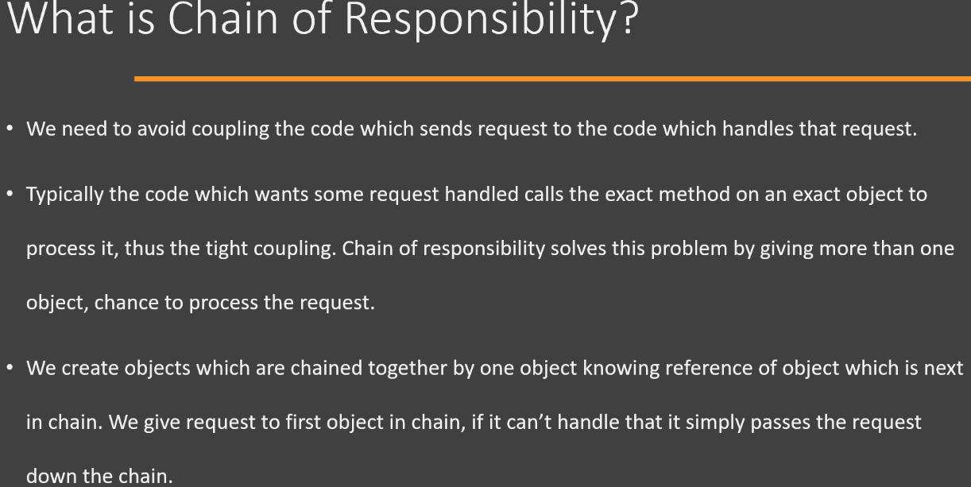
Definition

Slide 49
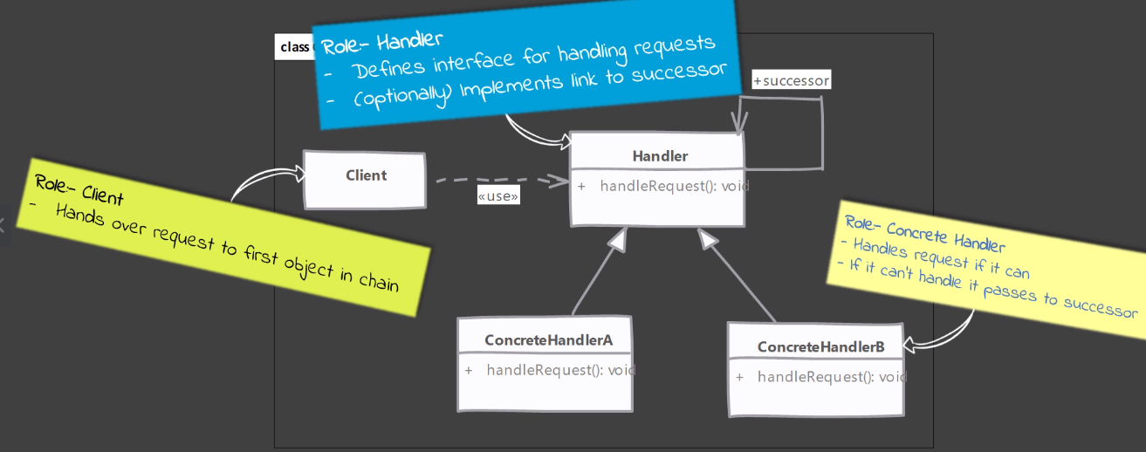
UML class Diagram

Slide 50
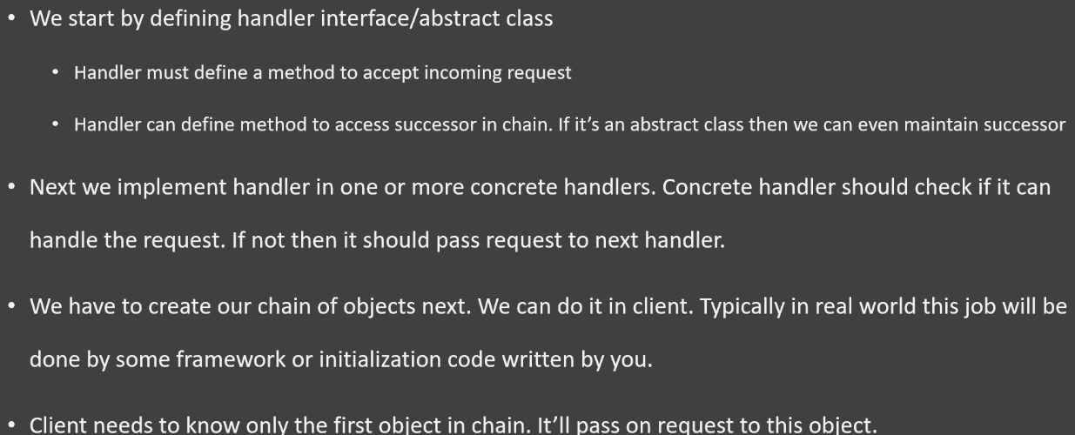
Implementation steps

Slide 51
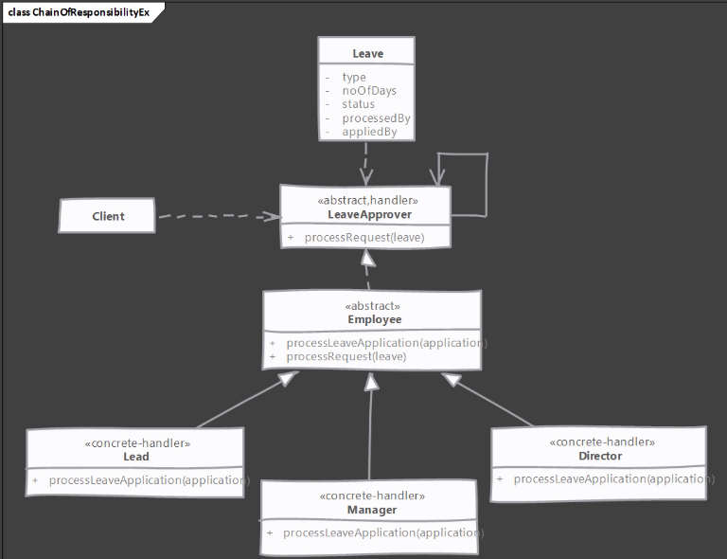
Example

Slide 52
Questions

Slide 53
Memento Design Pattern

Slide 54
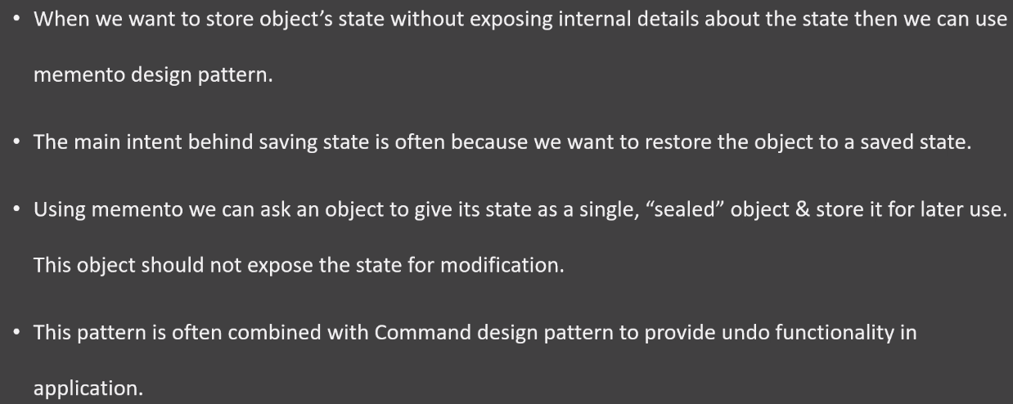
Defn

Slide 55
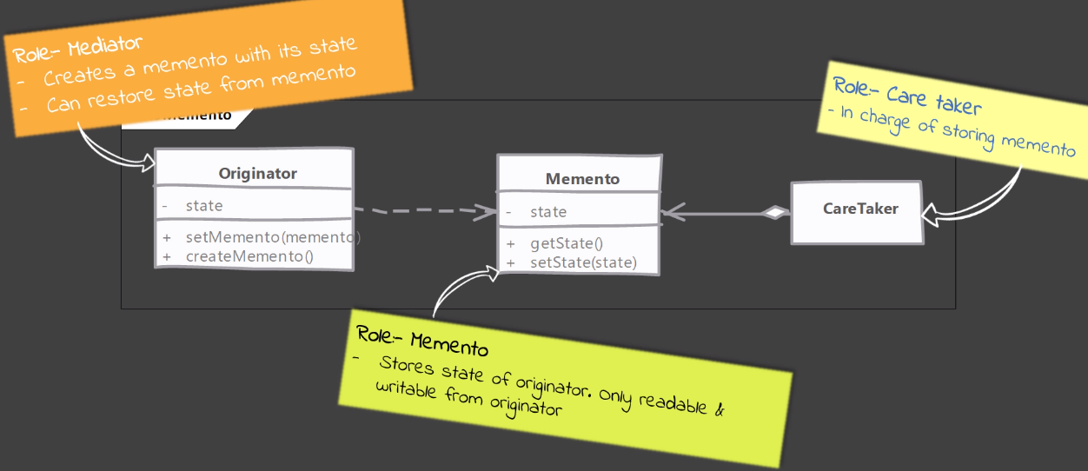
UML Class diagram

Slide 56
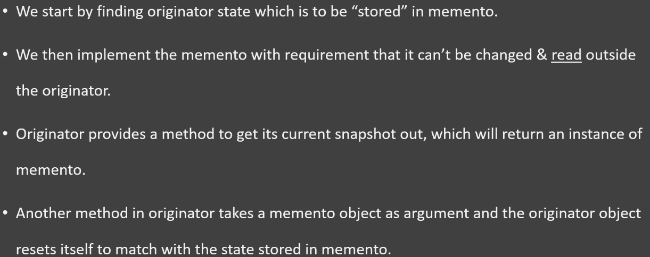
Implementation

Slide 57
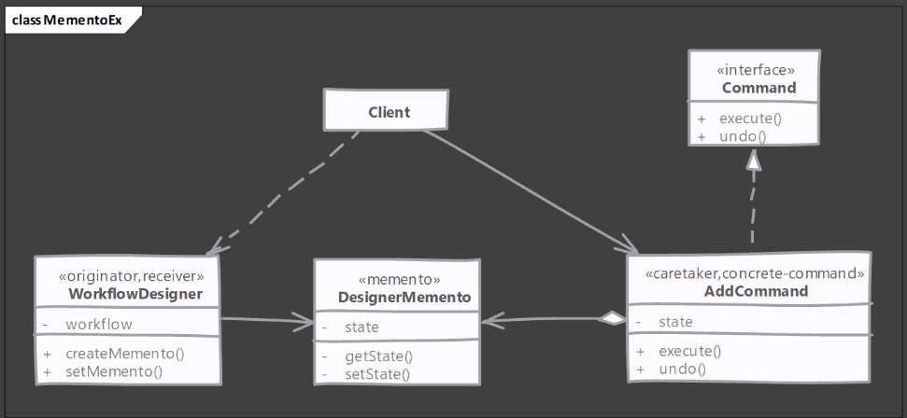
Example

Slide 58
Questions
-Chain of Responsibility
-Memento

Slide 59
State Design Pattern

Slide 60
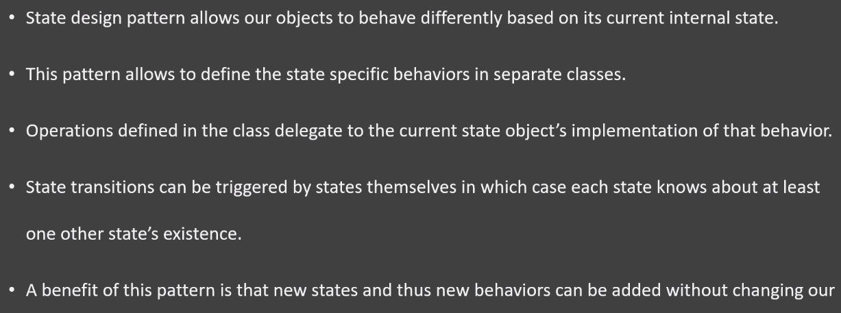
Definition

Slide 61
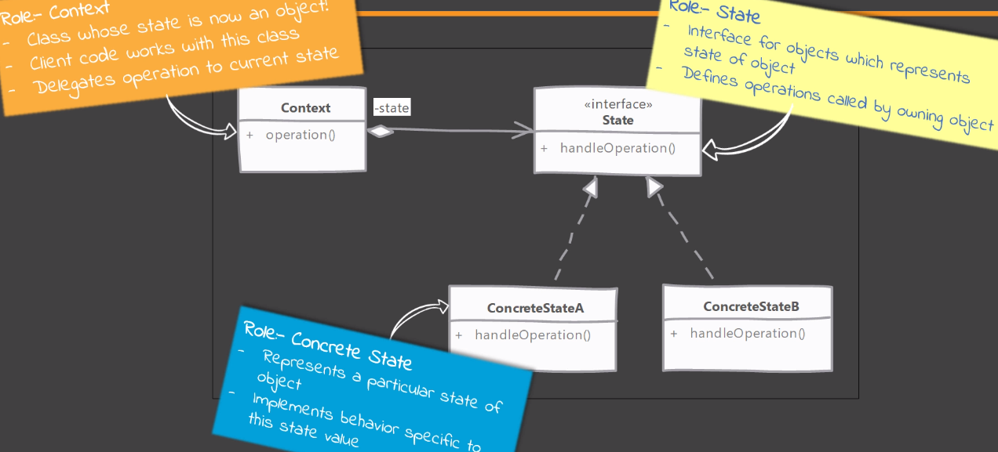
UML class diagram

Slide 62
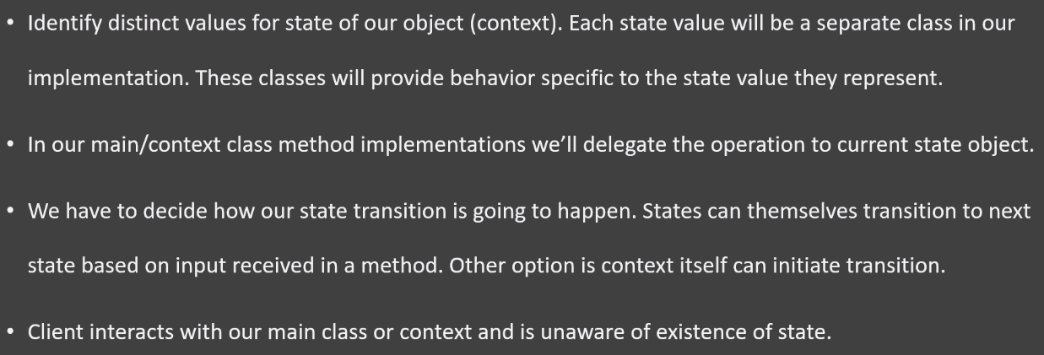
Implementation

Slide 63
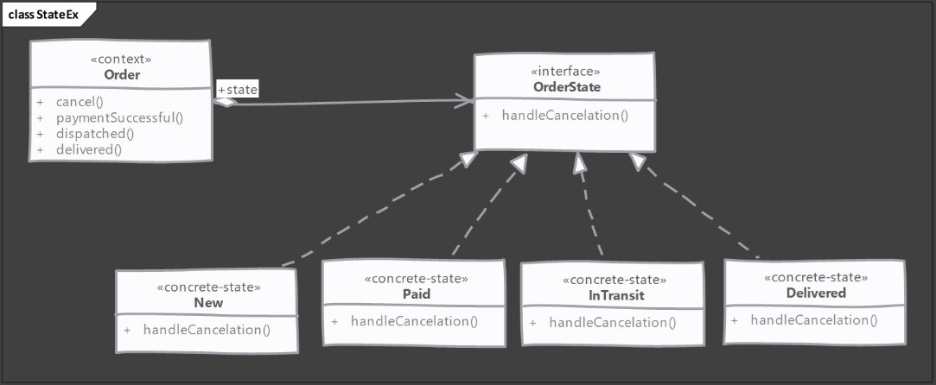
Example

Slide 64
Template Method Pattern

Slide 65
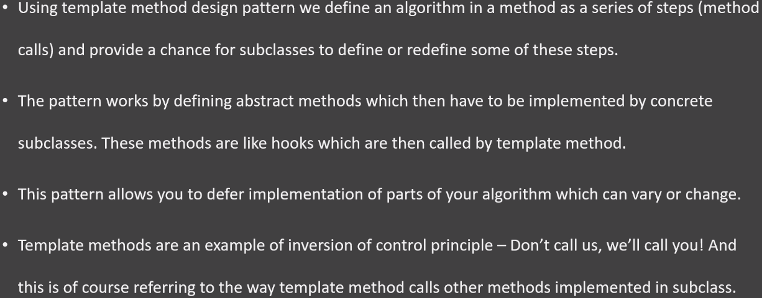
Defn

Slide 66
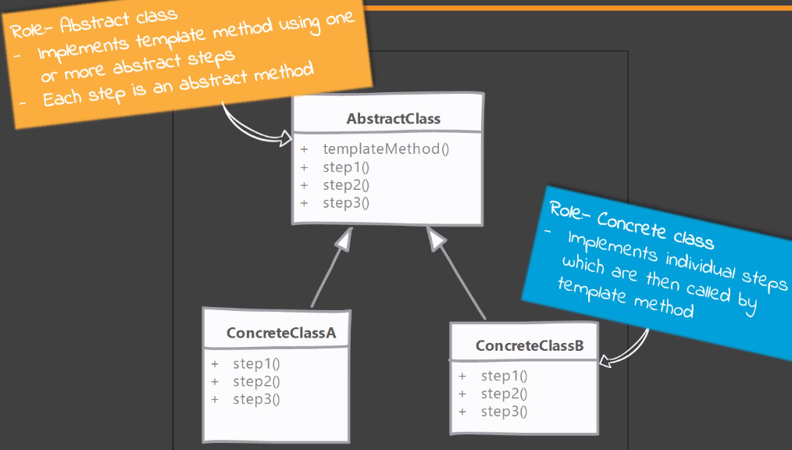
Class diagram

Slide 67
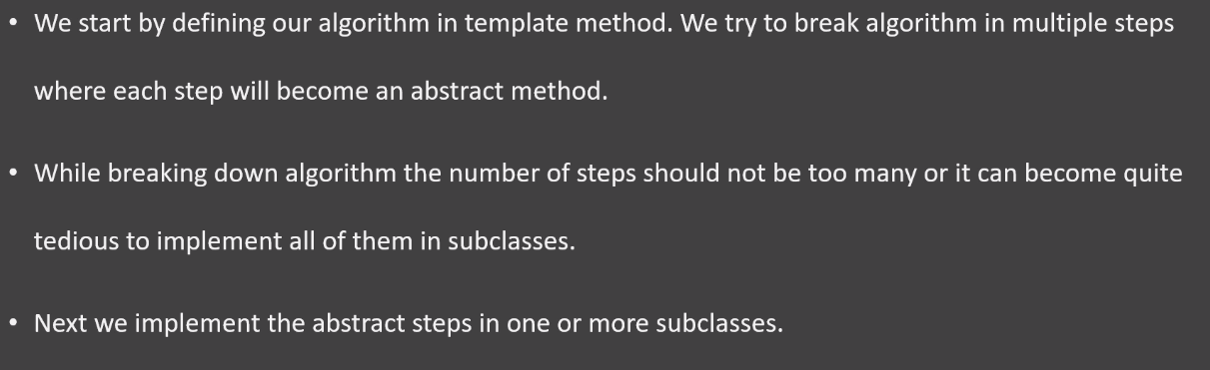
Implementation

Slide 68
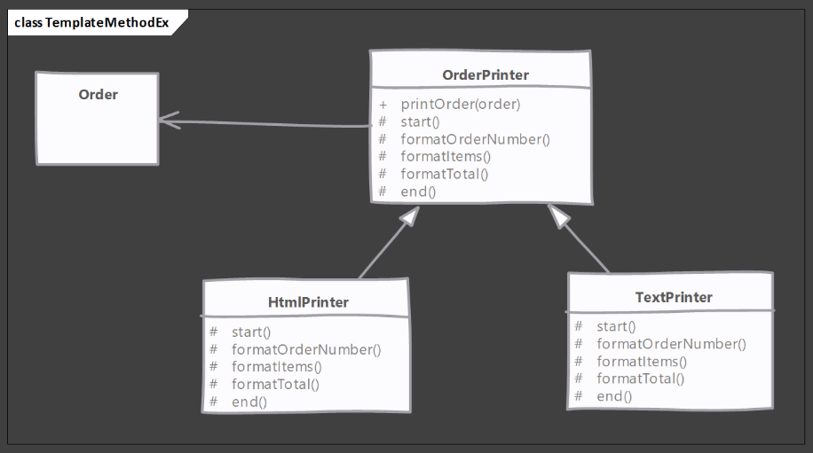
Example

Slide 69
Ques

Slide 70
Behavioral design patterns
Chain of Responsibility
Memento
Template
State
Strategy
Observer
Command

